Slide 1
Econometrics 871 Time Series
Topic 4: Tutorial
Replicating the Dickey-Fuller distribution

Slide 2
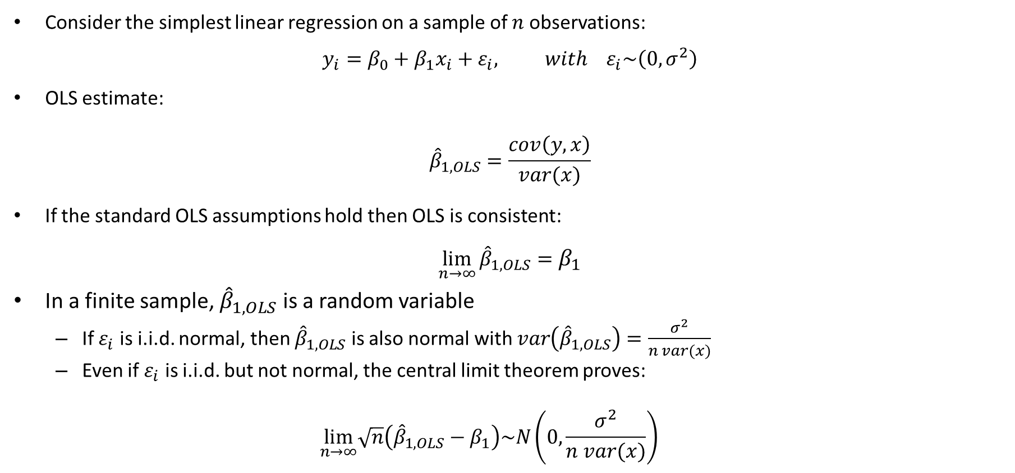
Review of asymptotic results and hypothesis testing
Consider the simplest linear regression on a sample of $n$ observations:
$$y_{i}=β_{0}+β_{1}x_{i}+ε_{i}, with ε_{i}\sim \left(0,σ^{2}\right)$$
OLS estimate:
$${\hat{β}}_{1,OLS}=\frac{cov\left(y,x\right)}{var(x)}$$
If the standard OLS assumptions hold then OLS is consistent:
$$\lim_{n→∞}{{\hat{β}}_{1,OLS}}=β_{1}$$
In a finite sample, ${\hat{β}}_{1,OLS}$ is a random variable
If $ε_{i}$ is i.i.d. normal, then ${\hat{β}}_{1,OLS}$ is also normal with $var\left({\hat{β}}_{1,OLS}\right)=\frac{σ^{2}}{n var(x)}$
Even if $ε_{i}$ is i.i.d. but not normal, the central limit theorem proves:
$$\lim_{n→∞}\sqrt{n}\left({\hat{β}}_{1,OLS}−β_{1}\right)\sim N\left(0,\frac{σ^{2}}{n var(x)}\right)$$

Slide 3
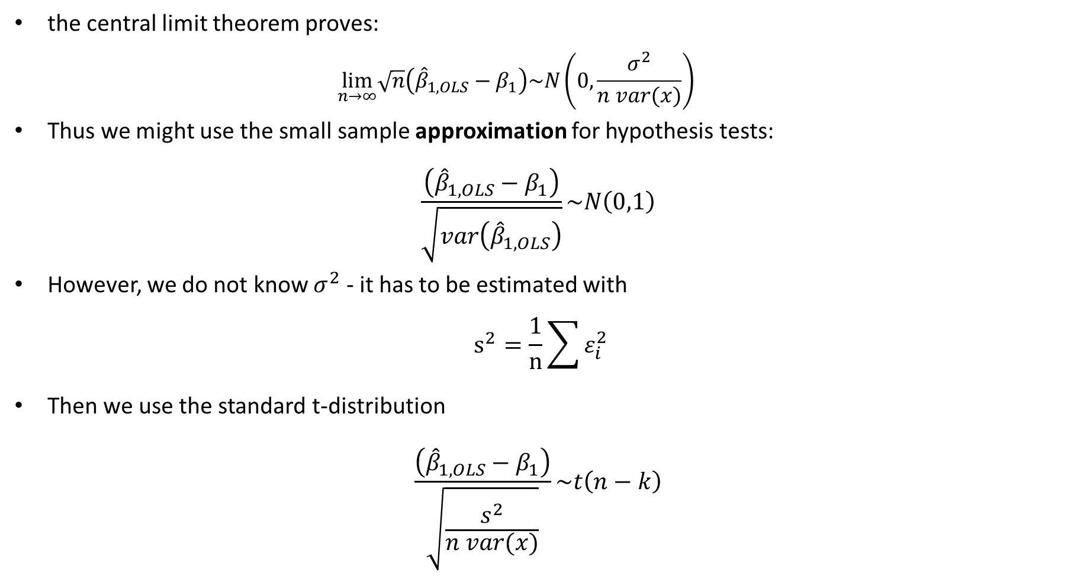
Review of asymptotic results and hypothesis testing
the central limit theorem proves:
$$\lim_{n→∞}\sqrt{n}\left({\hat{β}}_{1,OLS}−β_{1}\right)\sim N\left(0,\frac{σ^{2}}{n var(x)}\right)$$
Thus we might use the small sample approximation for hypothesis tests:
$$\frac{\left({\hat{β}}_{1,OLS}−β_{1}\right)}{\sqrt{var\left({\hat{β}}_{1,OLS}\right)}}\sim N\left(0,1\right)$$
However, we do not know $σ^{2}$ - it has to be estimated with
$$s^{2}=\frac{1}{n}\sum{ε_{i}^{2}}$$
Then we use the standard t-distribution
$$\frac{\left({\hat{β}}_{1,OLS}−β_{1}\right)}{\sqrt{\frac{s^{2}}{n var(x)}}}\sim t\left(n−k\right)$$

Slide 4
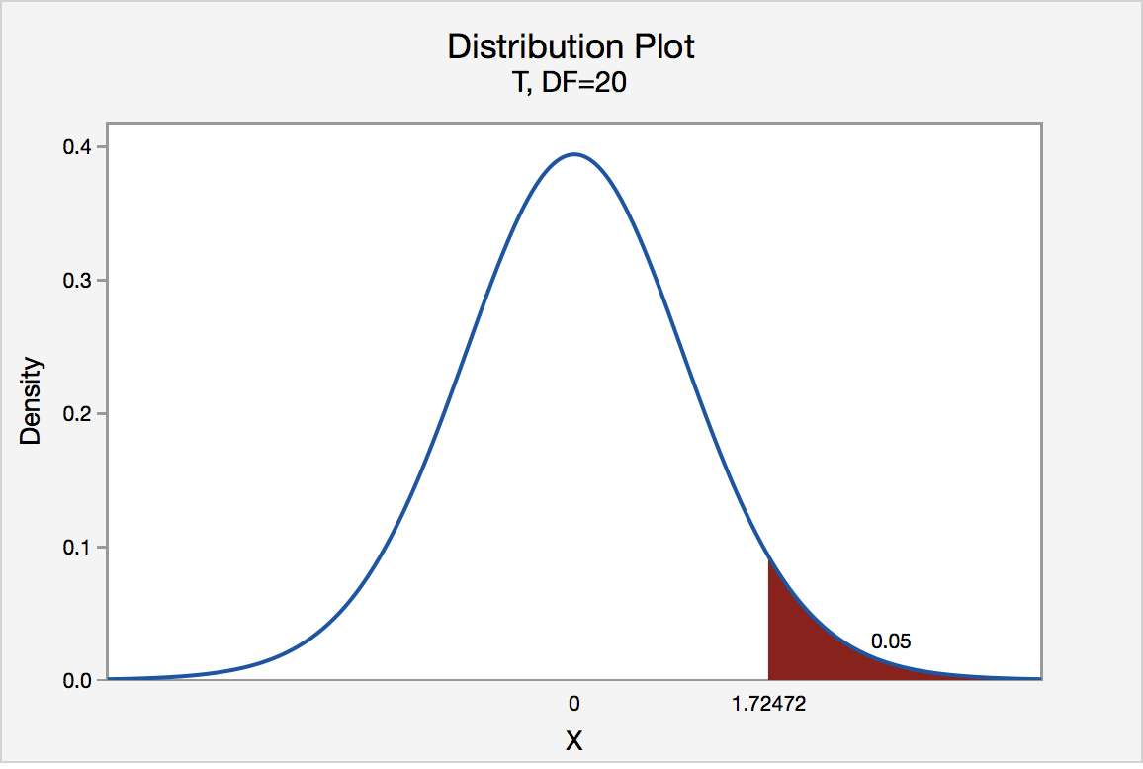

Slide 5
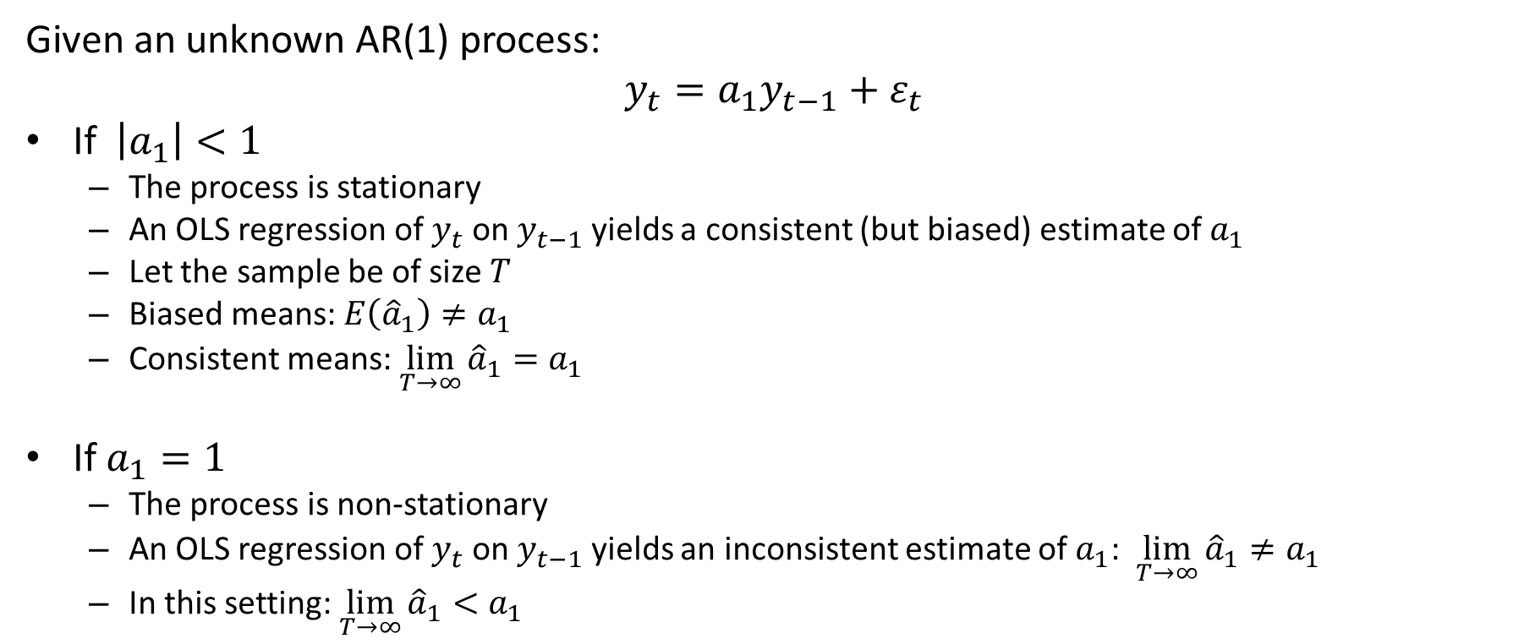
Fundamental Setting
Given an unknown AR(1) process:
$$y_{t}=a_{1}y_{t−1}+ε_{t}$$
If $\left|a_{1}\right|<1$
The process is stationary
An OLS regression of $y_{t}$ on $y_{t−1}$ yields a consistent (but biased) estimate of $a_{1}$
Let the sample be of size $T$
Biased means: $E\left({\hat{a}}_{1}\right)≠a_{1}$
Consistent means: $\lim_{T→∞}{{\hat{a}}_{1}}=a_{1}$
If $a_{1}=1$
The process is non-stationary
An OLS regression of $y_{t}$ on $y_{t−1}$ yields an inconsistent estimate of $a_{1}$: $\lim_{T→∞}{{\hat{a}}_{1}}≠a_{1}$
In this setting: $\lim_{T→∞}{{\hat{a}}_{1}}<a_{1}$

Slide 6
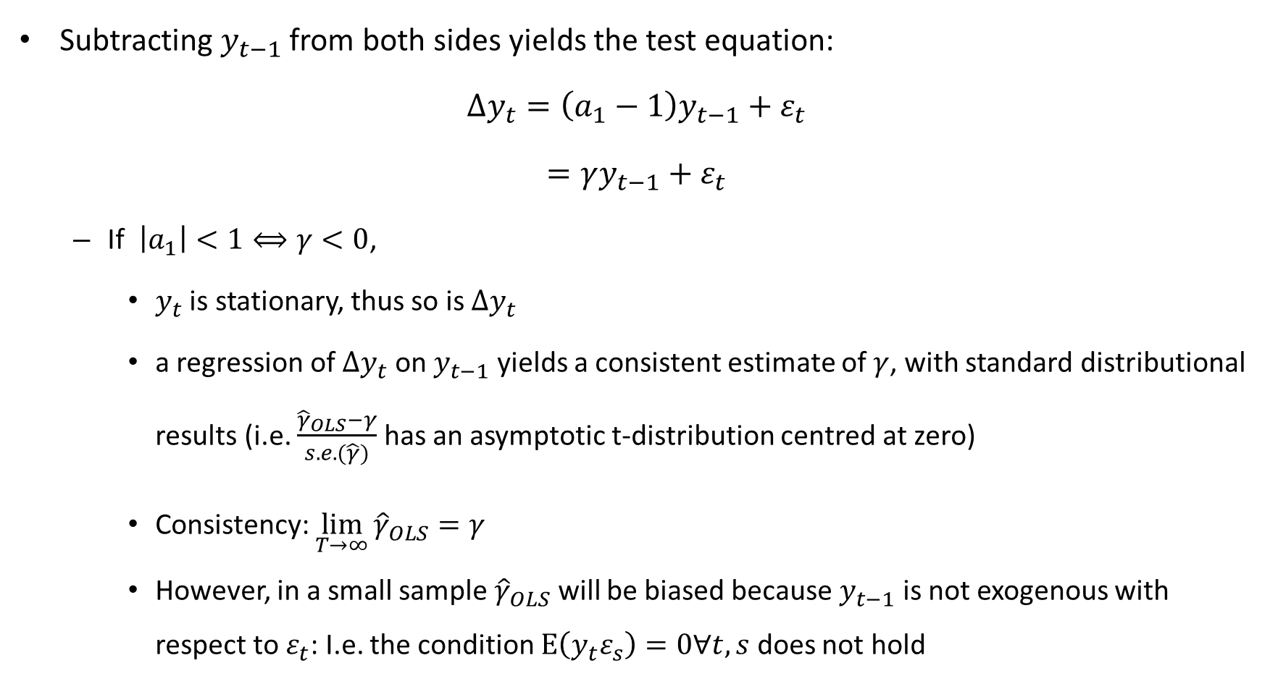
Test equation:
Subtracting $y_{t−1}$ from both sides yields the test equation:
$$∆y_{t}=\left(a_{1}−1\right)y_{t−1}+ε_{t}$$
$$=γy_{t−1}+ε_{t}$$
If $\left|a_{1}\right|<1⟺γ<0$,
$y_{t}$ is stationary, thus so is $∆y_{t}$
a regression of ${∆y}_{t}$ on $y_{t−1}$ yields a consistent estimate of $γ$, with standard distributional results (i.e. $\frac{{\hat{γ}}_{OLS}−γ}{s.e.(\hat{γ})}$ has an asymptotic t-distribution centred at zero)
Consistency: $\lim_{T→∞}{{\hat{γ}}_{OLS}}=γ$
However, in a small sample ${\hat{γ}}_{OLS}$ will be biased because $y_{t−1}$ is not exogenous with respect to $ε_{t}$: I.e. the condition $E\left(y_{t}ε_{s}\right)=0∀t,s$ does not hold

Slide 7
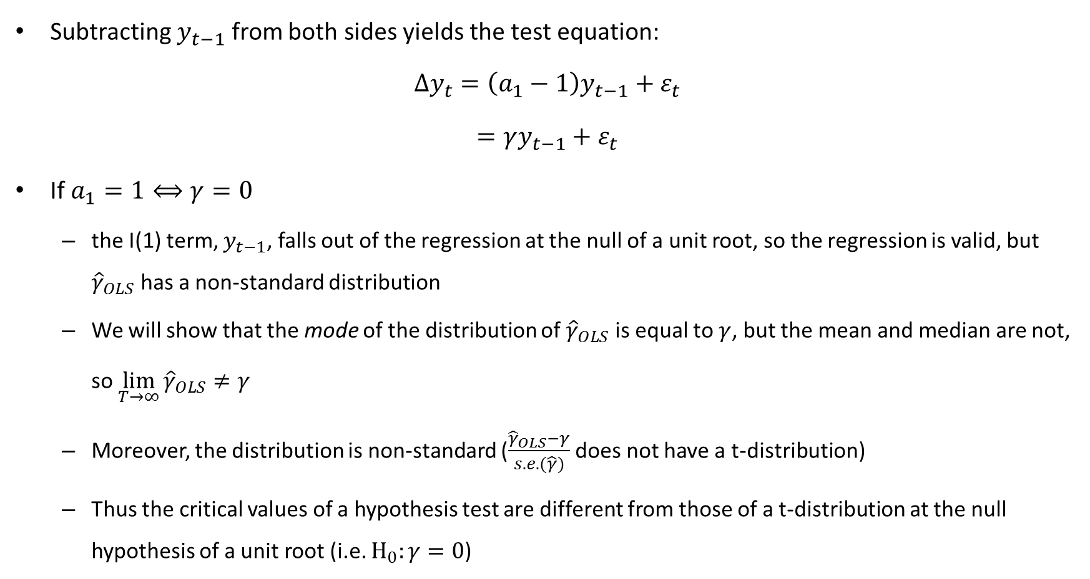
Test equation:
Subtracting $y_{t−1}$ from both sides yields the test equation:
$$∆y_{t}=\left(a_{1}−1\right)y_{t−1}+ε_{t}$$
$$=γy_{t−1}+ε_{t}$$
If $a_{1}=1⟺γ=0$
the I(1) term, $y_{t−1}$, falls out of the regression at the null of a unit root, so the regression is valid, but ${\hat{γ}}_{OLS}$ has a non-standard distribution
We will show that the mode of the distribution of ${\hat{γ}}_{OLS}$ is equal to $γ$, but the mean and median are not, so $\lim_{T→∞}{{\hat{γ}}_{OLS}}≠γ$
Moreover, the distribution is non-standard ($\frac{{\hat{γ}}_{OLS}−γ}{s.e.(\hat{γ})}$ does not have a t-distribution)
Thus the critical values of a hypothesis test are different from those of a t-distribution at the null hypothesis of a unit root (i.e. $H_{0}:γ=0$)

Slide 8
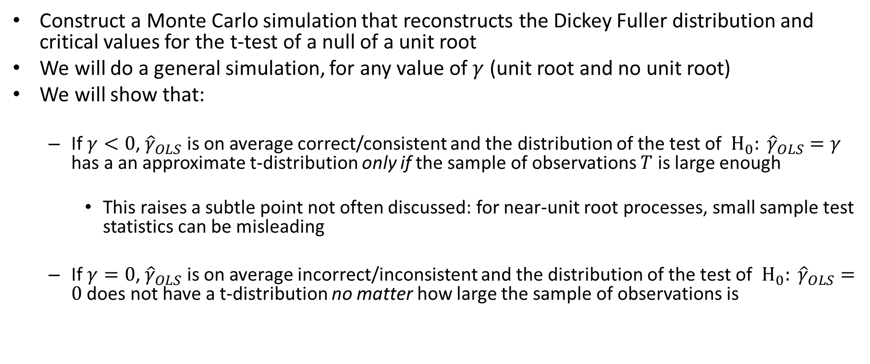
Exercise for the day:
Construct a Monte Carlo simulation that reconstructs the Dickey Fuller distribution and critical values for the t-test of a null of a unit root
We will do a general simulation, for any value of $γ$ (unit root and no unit root)
We will show that:
If $γ<0$, ${\hat{γ}}_{OLS}$ is on average correct/consistent and the distribution of the test of $H_{0}: {\hat{γ}}_{OLS}=γ$ has a an approximate t-distribution only if the sample of observations $T$ is large enough
This raises a subtle point not often discussed: for near-unit root processes, small sample test statistics can be misleading
If $γ=0$, ${\hat{γ}}_{OLS}$ is on average incorrect/inconsistent and the distribution of the test of $H_{0}: {\hat{γ}}_{OLS}=0$ does not have a t-distribution no matter how large the sample of observations is

Slide 9
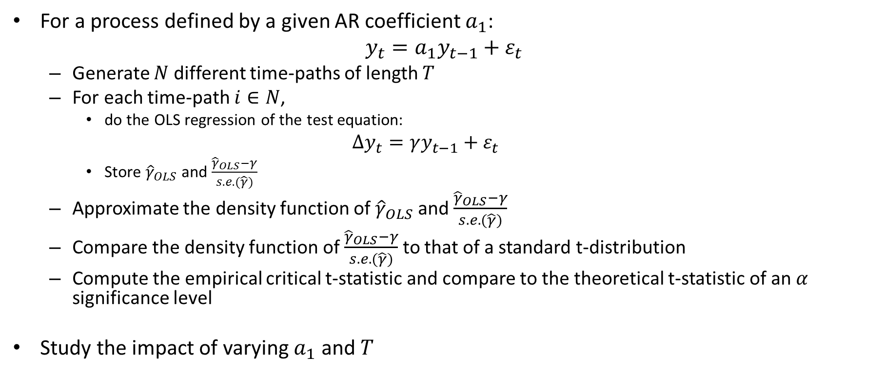
Monte Carlo Simulation
For a process defined by a given AR coefficient $a_{1}$:
$$y_{t}=a_{1}y_{t−1}+ε_{t}$$
Generate $N$ different time-paths of length $T$
For each time-path $i∈N$,
do the OLS regression of the test equation:
$$∆y_{t}=γy_{t−1}+ε_{t}$$
Store ${\hat{γ}}_{OLS}$ and $\frac{{\hat{γ}}_{OLS}−γ}{s.e.(\hat{γ})}$
Approximate the density function of ${\hat{γ}}_{OLS}$ and $\frac{{\hat{γ}}_{OLS}−γ}{s.e.(\hat{γ})}$
Compare the density function of $\frac{{\hat{γ}}_{OLS}−γ}{s.e.(\hat{γ})}$ to that of a standard t-distribution
Compute the empirical critical t-statistic and compare to the theoretical t-statistic of an $α$ significance level
Study the impact of varying $a_{1}$ and $T$

